Slide 1

A/B Testing
More than just A and B…
Patrick Ng

Slide 2
Why bother with A/B Testing?

Slide 3
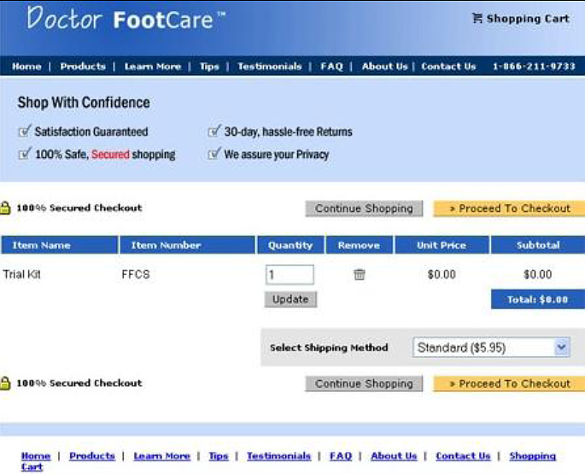
Scenario 1
You added a new feature to a website
Launched it.
Job done!
Work on the next change.
What is wrong here?

Slide 4
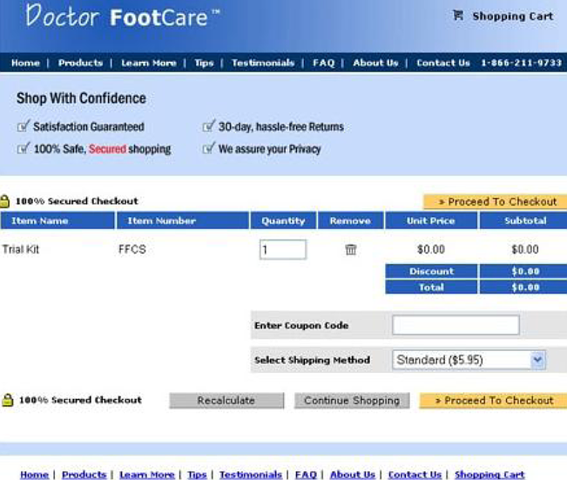
Scenario 1
Revenue dropped by 90%

Slide 5
Lesson learned: Need to measure the impact early

Slide 6

Scenario 2
You made a web design change to attract users to click 安心訂購
Launched it on Mar 1st
Monitor the daily click rate for one week
Mar 8th : daily rate increased by 5%
The design change is good. Declare victory! ☺
What could be wrong?

Slide 7
Possible Reasons
New design is good and users like it!
Seasonal changes (e.g. Christmas, Valentine’s Day)
Promotion from vendors
Promotion from Price.com.hk
Pure luck
Many possible explanations. “new design” ← the key reason for click rate increase?

Slide 8
Ok. Then let’s do A/B Testing

Slide 9
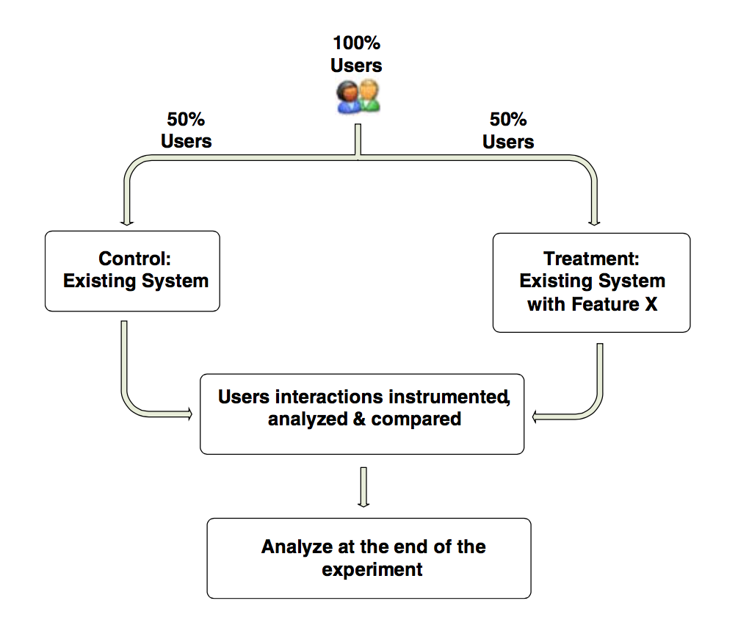
High-level flow for an A/B Test
External factors apply to both groups! The only difference is “new feature” or not.

Slide 10
Lesson learned: Need to do A/B testing

Slide 11
Scenario 3
You made a web design change to attract users to click 安心訂購
Launch an A/B Testing on Mar 1st
Collect data for one day
Measure total number of clicks
Result:
A: 300
B: 330
10% increase. Declare victory! ☺
What could be wrong?

Slide 12
Look at a scenario
Assume:
Size of group A = 1000
When a user sees the button:
Probability of clicking = 3%
Size of group B: 1000
But:
We have a bug in code
Group B users actually see the same thing
Same probability of clicking: 3%
Let’s do a simulation (coding time! ☺)

Slide 13
What could go wrong?
Size of group A = Size of group B = 1000
Same probability: 0.03 (i.e. existing click rate = 0.03 or 3%)
In our simulation:
If you do the same A/B Test 10,000 times…
In ~30% of A/B tests, “click rates” is 0.033 or higher
Increase sample size to 5,000
In ~20% of A/B tests, “click rates” is 0.033 or higher
Key question: Is the difference statistically significant? (translated: how lucky were you?)

Slide 14
Finding the right sample size depends on…
Minimum Effect size (i.e. sensitivity) we want to detect (case by case)
E.g. OEC = conversion rate. Current is 0.1. We want to detect an increase of 10%.
If we want to reliably detect an effect:
The bigger the “minimum effect size”, the smaller the required sample size.
Required Power (standard: 0.8 or 0.9)
The ability to detect the treatment effect when it indeed exists
Inversely proportional to the “number of users squared”
E.g. if we need 10,000 users to detect a 5% delta, detecting a 0.5% delta requires 10^2 times more user = 1,000,000 users.
Most change have small effect.
Significance level chosen (standard: 0.05)
The probability of reject the null hypothesis (that there is ne effect)
The statistical test employed (e.g. t-test)
The noise (variance) of the measure

Slide 15
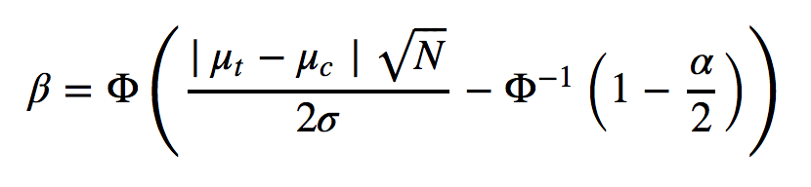
Finding the right sample size
The power of an experiment
β = Desired Statistical Power of the experiment (typically 0.8 to 0.95)
Pr (detect an effect | there is really an effect)
μ_{t} = average outcome in treatment
μ_{c} = average outcome in control
σ = standard deviation in both group’s outcomes
N = total sample size, assuming even distribution
α = the desired level of statistical significance (typically 0.05)
Φ(∙) = the normal cumulative distribution function

Slide 16
Next: What should we measure?

Slide 17
Overall Evaluation Criterion (OEC)
Also called Key Performance Indicator (KPI)
Sometimes it looks easy.
E.g.
Conversion rate at registration page
Clicks generated by the product page
It could be tricky.

Slide 18
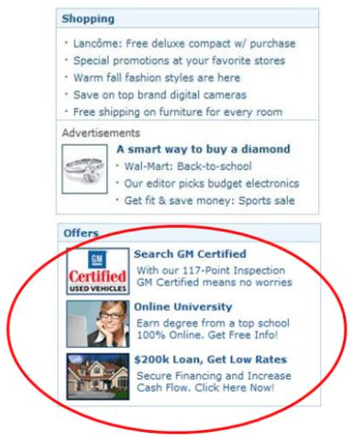
MSN Home Page: Special Offers
MSN wanted to add an Offers widget on the homepage
Estimated good revenue from it.
Obvious OEC:
Revenue generated from these offers
What’s missing?
Impact on user experience
But how to measure “user experience”?
Measure impact on:
Homepage PV on homepage
# of referrals from homepage to other MSN sites
Assign monetary value to each one

Slide 19
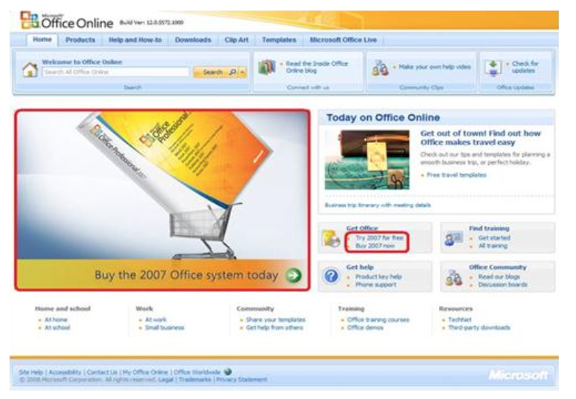
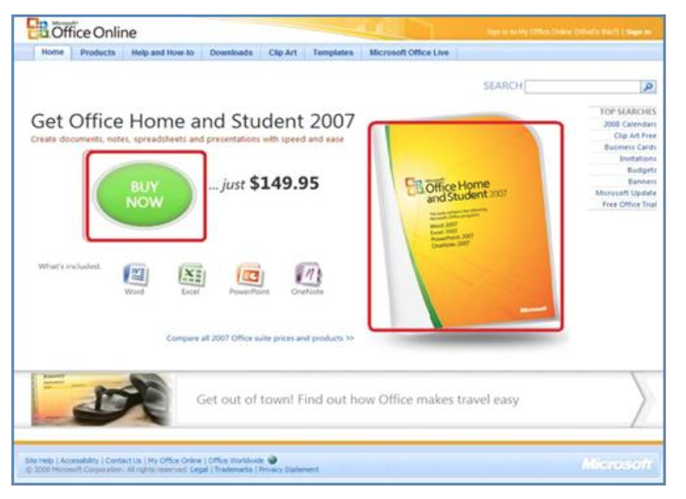
Office 2007 Online purchase site
They used click rate as OEC
B: Click rate dropped, but purchase rate increased
Control Design (A): - Try 2007 for free - Buy 2007 now
Treatment Design (B): - Buy Now – just $149.95

Slide 20
Overall Evaluation Criterion (OEC)
Must be agreed upon before the experiment
Must be measureable
Must make business sense
Short-term gain vs. Long-term gain

Slide 21
Other things to watch out

Slide 22
Reason for Negative Result
Scenario: A feature change; do A/B Test; OEC is PV
Result: B generated 5% less PV than A did
Reason?
#1: Users don’t like the new feature
#2: B is slower (e.g. on average takes 10ms longer to render)
Slowdown could come from server side (e.g. extra DB read), client side (e.g. redirect) or both
One solution:
A/B/A’ Test
Engineer B and A’ to have the same speed

Slide 23
Novelty Effect and Inter-temporal Substitution
Novelty Effect:
Example:
Change: UI design; A/B Test
Want to measure “user engagement”
OEC = time spent on the page
Result:
B is higher than A by 10%
After one month, user are used to new design, and “user engagement” dropped to original level
Inter-temporal Substitution:
A fancy term ☺
E.g. A big sales for men’s suit

Slide 24
Impact of Internet Bots (web robots)
Many kinds: crawler, spambots, website scrapers, YouTube view bots, Bots to increase ad traffic (54% of ads view are by robots – comScore)
We cannot filter out all robots
We typically use browser cookie to store A/B assignment
Cookie-less robots – not too harmful
Cookie-ful robots – impact can be significant
See example
One solution:
Continuous A/A Test
Can be done offline

Slide 25

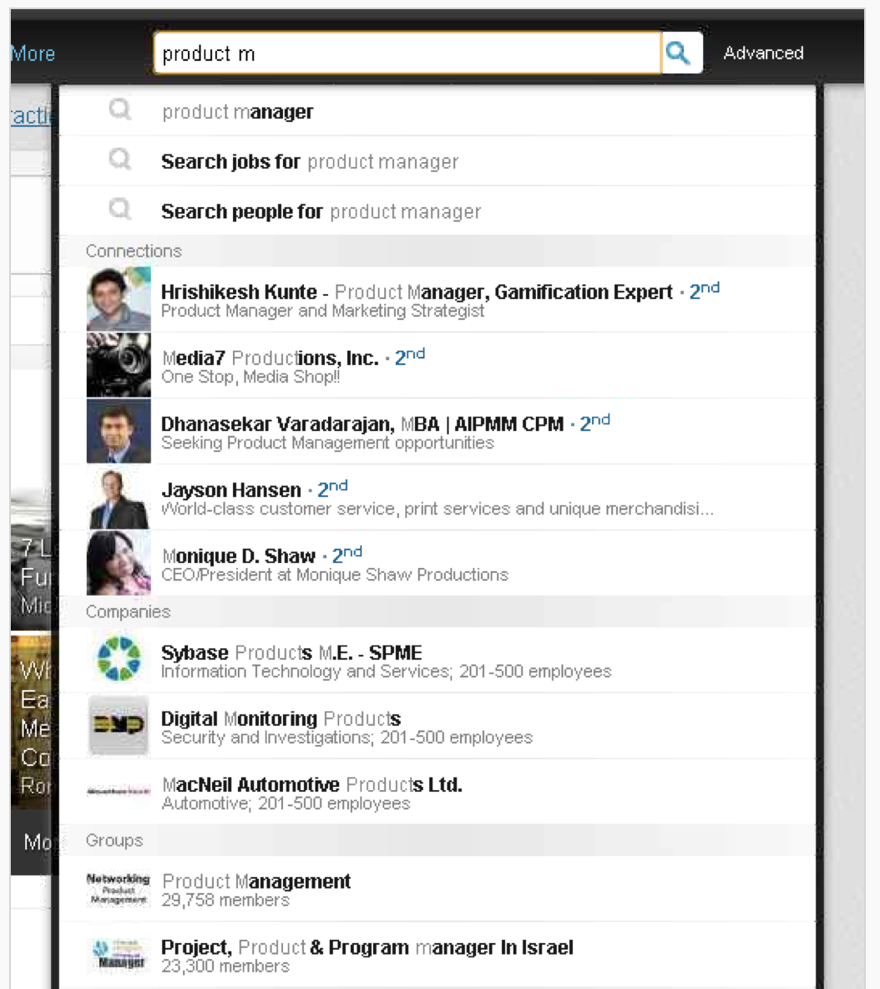
Avoid One Big Change
2013 LinkedIn introduced Unified Search
Autocomplete
Suggested phrasing
Unified search across different areas
Many design changes on search landing pages too.
Result:
Clicks and revenue dropped a lot!
Rollback:
Add back feature one at a time
Culprit: not unified search, but some other feature
Lesson:
Iterate and launch changes one at a time

Slide 26
A few final words

Slide 27
Most Ideas Fail to Show Value
Netflix: considered 90% of what they tried to be wrong. (Moran, 2007)
Microsoft: 2/3 of experiments done shows no or negative impact on the key metric (Kohavi, 2009)
QualPro:
Tested 150,000 business improvement ideas over 22years
75% of important business decisions and improvement ideas shows no or negative impact to business
Lessons:
Experiment often! (because most of them will fail; think of testing)
A failure of an experiment is not a mistake: learn from it
“Fail to experiment or do it incorrectly” is a mistake. ☺

Slide 28
Try radical or controversial ideas!
With experiment, you can try brave ideas!
A/B testing on a small percentage of users (e.g. 1%)
Positive result: expand!
Negative result: evaluate, drop it or improve
Amazon example:
Personalized recommendation based on items in shopping cart
The launch was banned by management
The developer did a controlled experiment
Feature was highly successful!
A/B testing encourages more Intuition and Creativity

Slide 29
Summary
Measure the impact of new feature / design change
A/B Testing – a fair comparison
Check statistical significance
Have to set an Overall Evaluation Criterion (OEC)
Experiments encourages trying out new ideas!
Experiment often, and correctly ☺

Slide 30
Thank you!

Slide 31
Backup slides

Slide 32
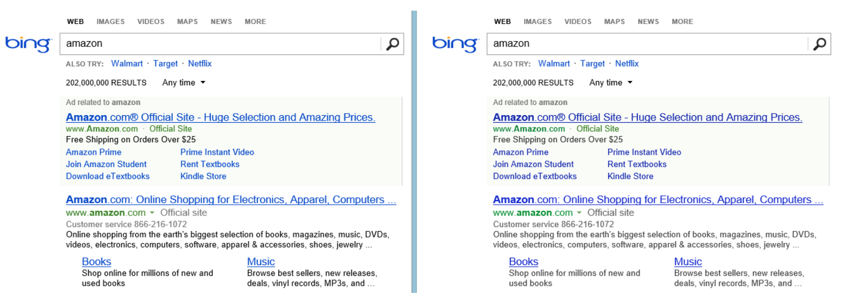

Don’t ignore Small Changes

Slide 33
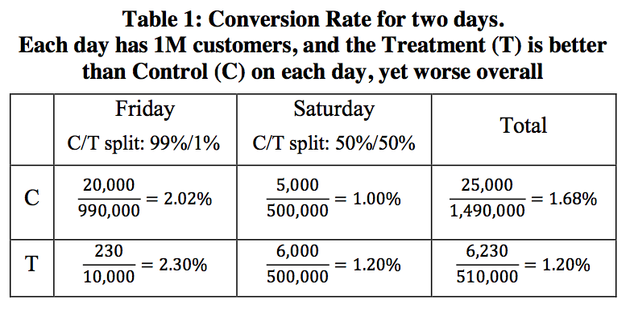
Simpson’s Paradox

